Slide 1
Advances in SCALE Monte Carlo Methods
Brad Rearden
SCALE Project Leader
Oak Ridge National Laboratory
Working Party on Nuclear Criticality Safety
Expert Group on Advanced Monte Carlo Techniques
September 17, 2012

Slide 2
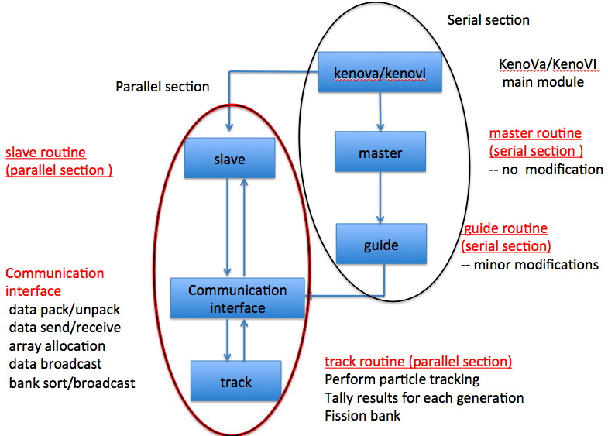
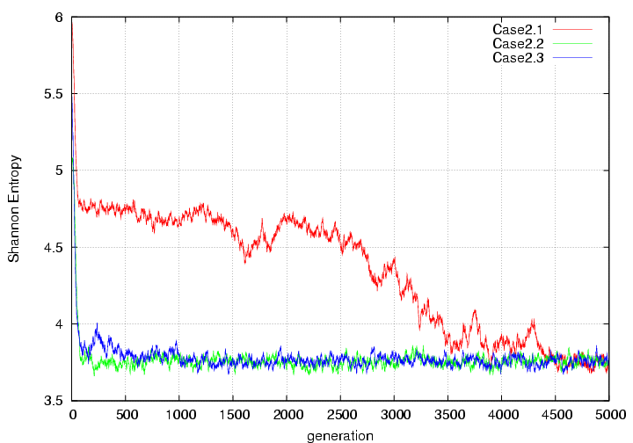
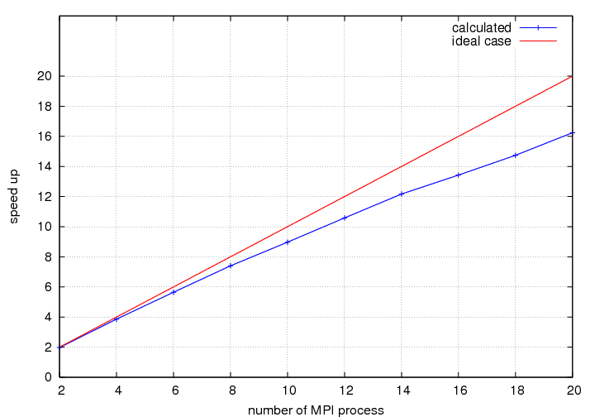
KENO Enhancements
Parallel KENO for SCALE 6.2
Fission source convergence diagnostics
Fission source convergence for different benchmark cases
Parallel
Speed-up

Slide 3
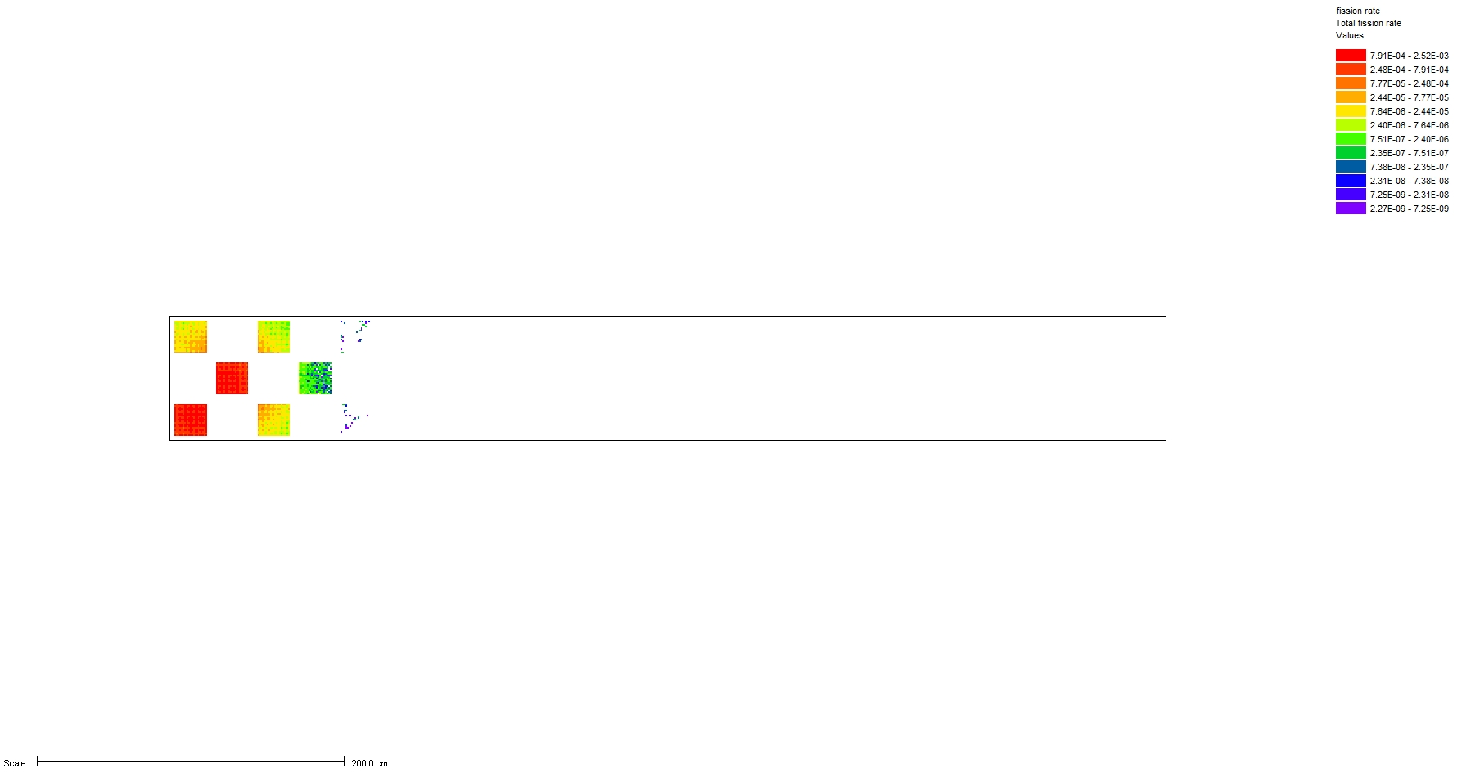
Fission Source Visualization
OECD Benchmark
Generation 1

Slide 4
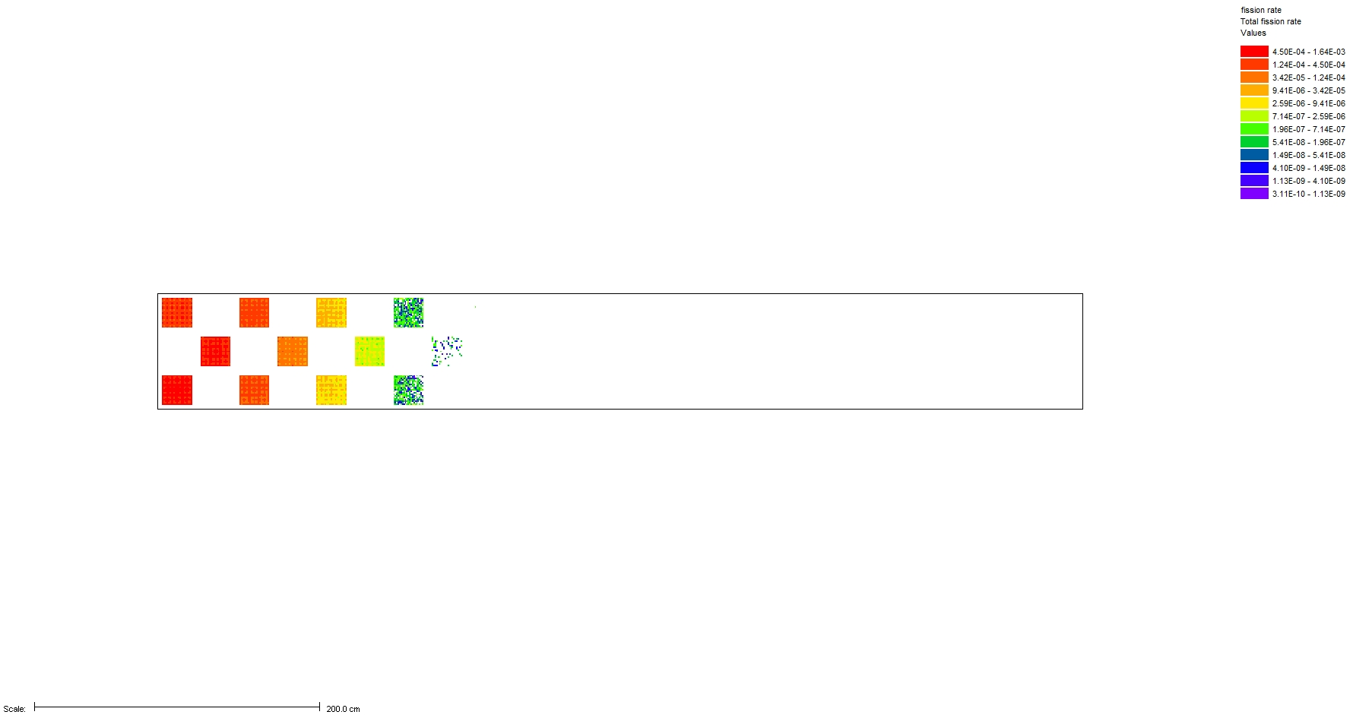
Fission Source Visualization
OECD Benchmark
Generation 50

Slide 5
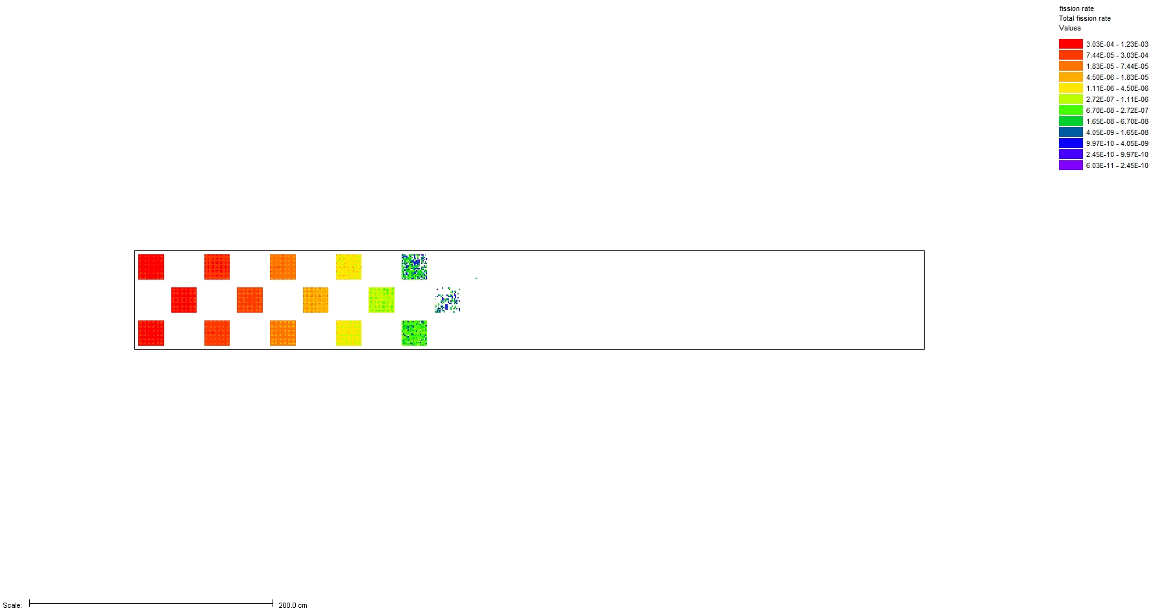
Fission Source Visualization
OECD Benchmark
Generation 100

Slide 6
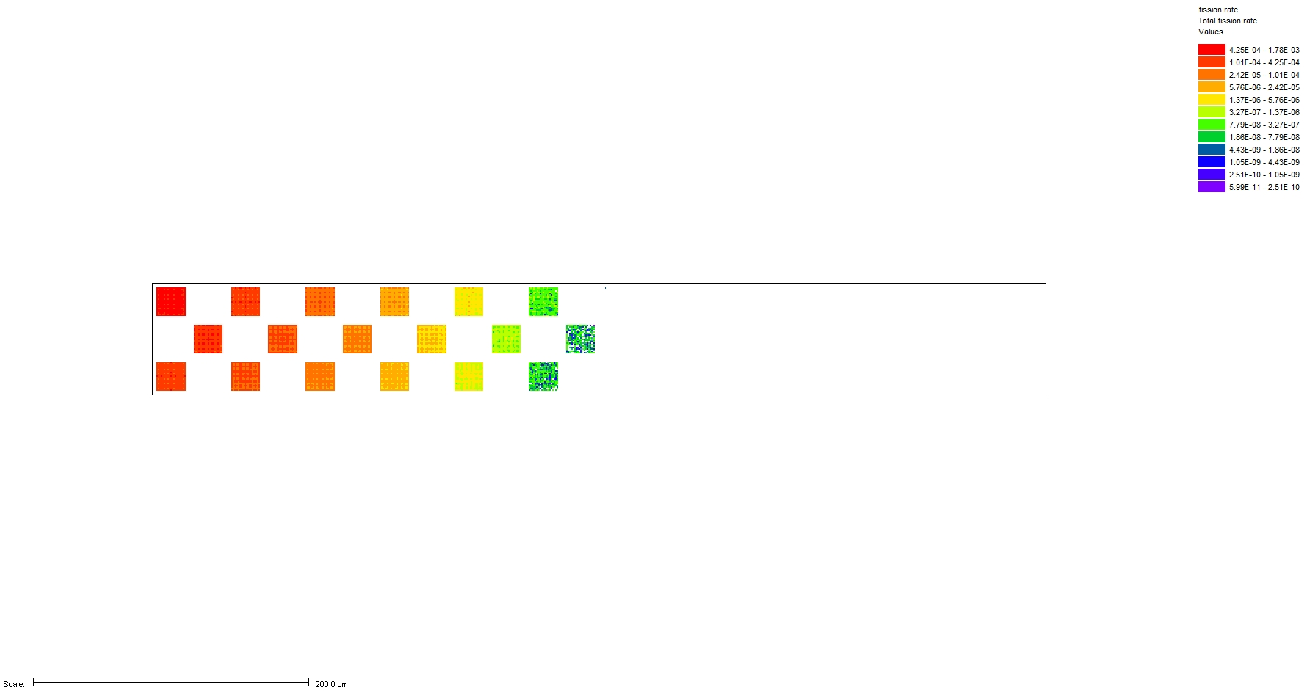
Fission Source Visualization
OECD Benchmark
Generation 250

Slide 7
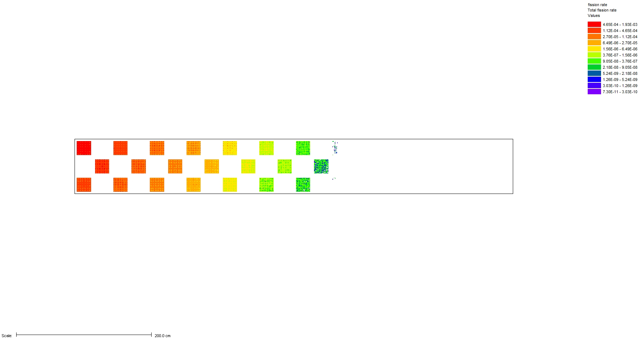
Fission Source Visualization
OECD Benchmark
Generation 500

Slide 8
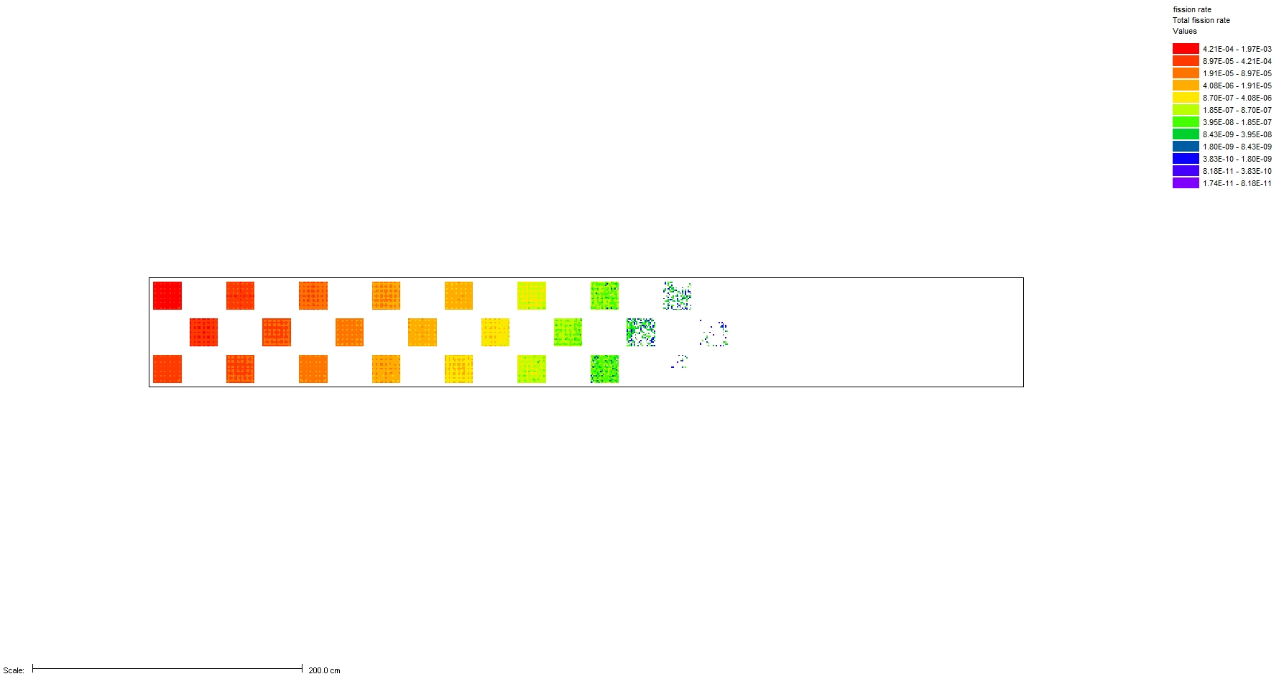
Fission Source Visualization
OECD Benchmark
Generation 1000

Slide 9
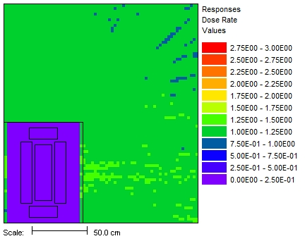
Continuous-Energy Shielding
Extending KENO continuous-energy physics to MAVRIC neutron-gamma shielding calculation with automated variance reduction
Creating SCALE CE Modular Physics Package (SCEMPP)
Interrogating and improving SCALE CE data and AMPX processing codes
The representation of a cobalt-60 source using the SCALE 47-group and 19-group structures. The actual cobalt lines are also shown as black dotted lines.
Ratio of the 47-group MG computed dose rates to the CE dose rates

Slide 10
Sensitivity and Uncertainty Analysis
SCALE 6.1
Future
Eigenvalue and reactivity sensitivities
  1D, 2D, 3D
“Generalized” sensitivities (reaction rate, flux, XS collapse, etc)
  1D, 2D
Adjoint based
  Requires 2 calculations per response
  Multigroup calculations only
  Requires mesh results for Monte Carlo → Large memory requirements
Eigenvalue, reactivity, and generalized sensitivities
  Advanced Monte Carlo method “CLUTCH”
  Faster, less memory
  Continuous-energy and multigroup
  PhD dissertation

Slide 11
Other Developments for SCALE 6.2
Improved CE KENO results
New 252 group ENDF/B-VII.0 cross sections, especially for LWR lattices
Ability to optionally disable unionized energy grid for continuous-energy calculations
  Increase in runtime (~2x)
  Decrease in memory f(number of mixtures)
Increased maximum allowed mixtures from ~2,000 to ~2 billion
Investigating continuous-energy depletion

Slide 12
SCALE Monte Carlo Evolution through SCALE 6.2
View as animation
KENO-VI
KENO V.a
Parallel
Depletion
Eigenvalue
Basic Geometry
Generalized Geometry
MG Physics
CE Physics
Shielding
Variance Reduction
Morse
Monaco

Slide 13
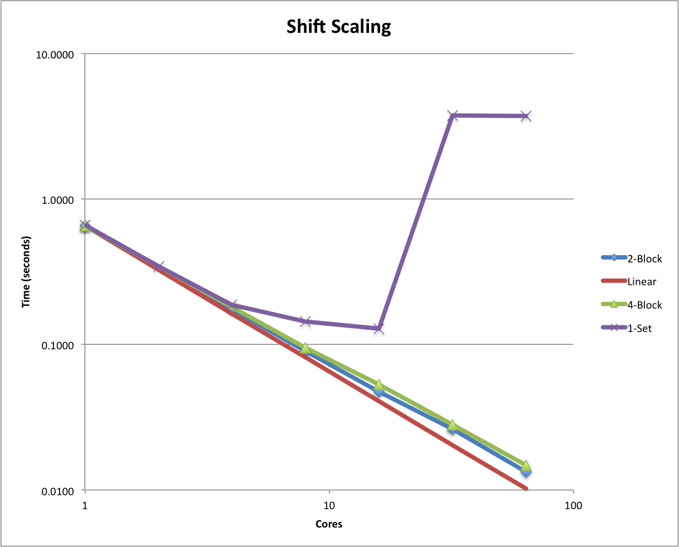
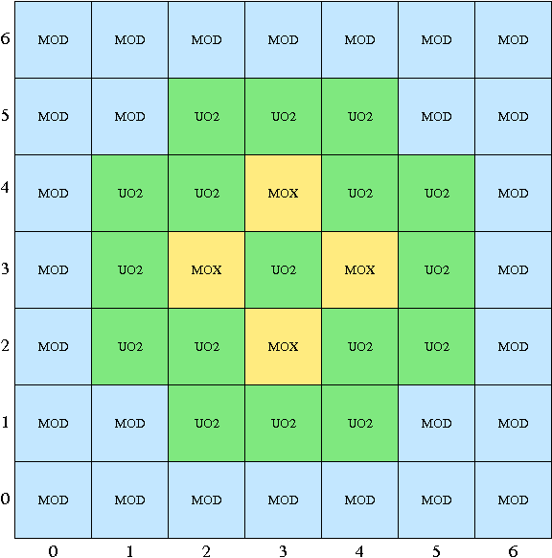
New Parallel Monte Carlo code, Shift
Initial prototype development sponsored by ORNL Laboratory Direct Research and Development (LDRD) project
Designed from outset for use on massively parallel platforms
  Domain replication and domain decomposition
  Parallel scaling studies on-going
SCALE generalized geometry
Implementing hybrid methods
(Shift + Denovo in common code base)
Approaches for efficient variance estimation
Implementing continuous energy physics
Implemented Shannon Entropy
Testing, verification and validation
Relative difference between variances estimated on 1 and 4 domains for a 2x2 assembly model

Slide 14
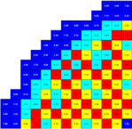
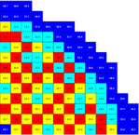
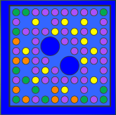
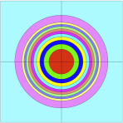
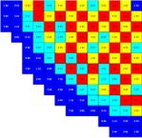
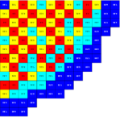
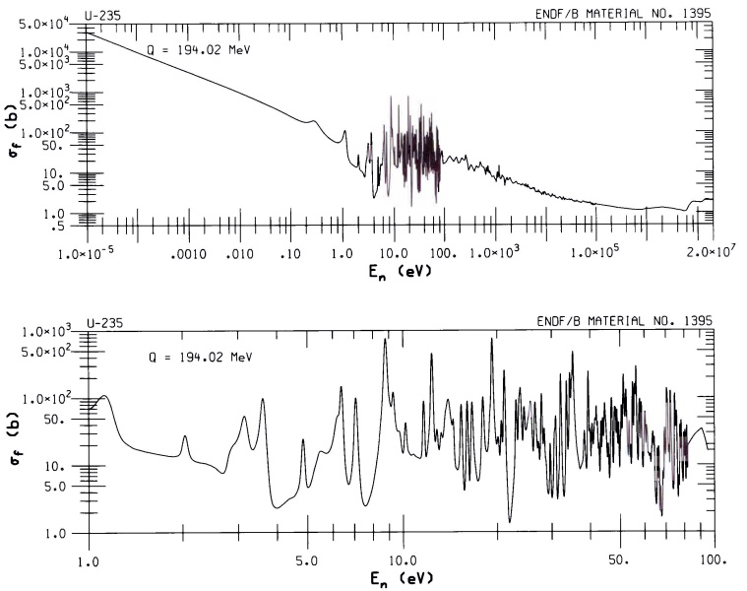
Shift LDRD Goal: Enable efficient full-core Monte Carlo reactor simulations on HPC platforms
Current industry state-of-the-art methodology
  Based on nodal framework (late 1970’s)
  High-order transport at small scale, diffusion at large scale
  Single workstation paradigm
Continuous-energy Monte Carlo (MC)
  Explicit geometric, angular and nuclear
  data representation – highly accurate
  Avoids problem-dependent multigroup
  xs processing – easy to use
  Computationally intensive – considered prohibitive for “real” reactor analyses
pin cell
lattice cell
nodal core model
U-235 fission cross section
CHALLENGE: Prohibitive computational TIME and MEMORY requirements

Slide 15
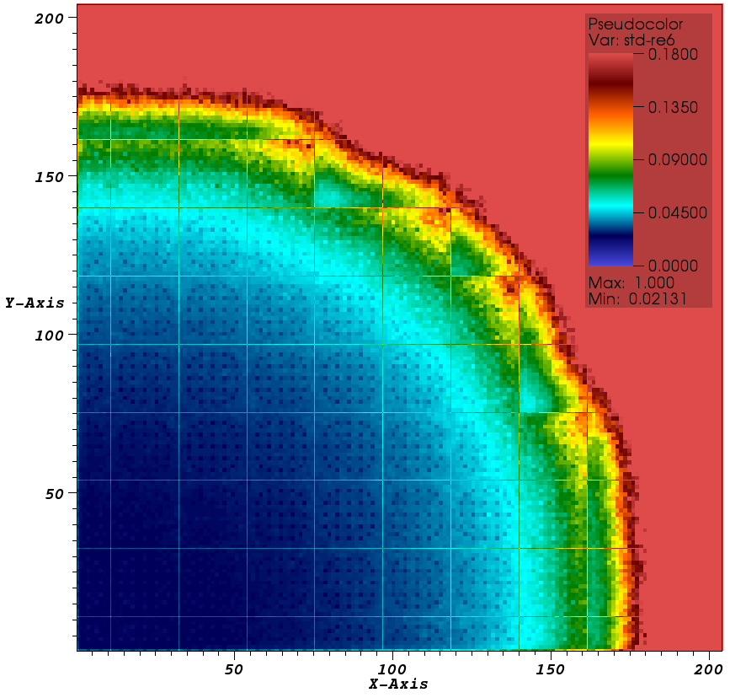
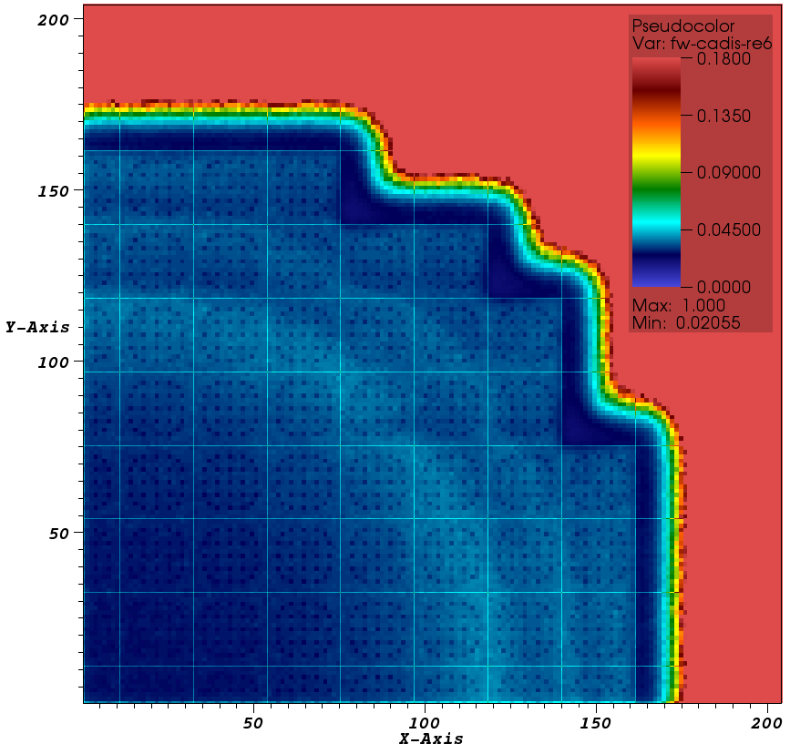
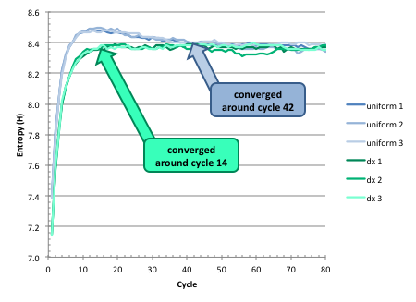
FW-CADIS method helps to overcome prohibitive computational TIME requirements
FW-CADIS currently used in MAVRIC
FW-CADIS deterministic solution can be exploited in other ways:
Generate initial fission source and k for MC
  accelerate source convergence
  Improve convergence reliability
Select domain boundaries
  improve parallel load balancing
  reduce Monte Carlo run time
Conventional MC
MC w/FW-CADIS
300 min MC
50 min DX + 250 min MC
Statistical uncertainties in group 6 fluxes (0.15 to 0.275eV)
 | MCNP | FW-CADIS
Uncertainty range | 0.6 – 16.2% | 1.0 – 6.6%
Time to < 2% uncertainty | 323 hrs | 45 hrs
Speed up (includes Denovo run time) | - | 7.1*
*depending on computational parameters,
the speed-up varied between 6 and 10

Slide 16
Domain decomposition parallelism overcomes prohibitive computational MEMORY requirements
Novel multi-set overlapping domain (MSOD) parallel algorithm implemented in new Monte Carlo code - Shift
Pictorial representation of MSOD parallel decomposition. Here the core geometry is decomposed into N_{s} = 4 sets. Each set has N_{b} blocks with overlapping regions such that the total number of parallel domains is N_{b} × N_{s}. Particles are decomposed across sets where the number of particles per set is N_{p,s} = N_{p} / N_{s}. Each block can define an overlapping domain (shown in inset) to reduce block-to-block communication for particles that scatter at the interfaces between blocks.
J.C. WAGNER, S.W. MOSHER, T.M. EVANS, D.E. PEPLOW, and J.A. TURNER, “Hybrid and Parallel Domain-Decomposition Methods Development to Enable Monte Carlo for Reactor Analyses,” accepted for publication in Progress Nucl. Sci. Technol.
Notes:
MC DD algorithm has been developed for addressing prohibitive memory requirements
Uses multi-set/block decomposition for load-balancing and
to reduce communication time/cost
Uses over-lapping regions to reduce communications
Expected benefits include:
no communication (message passing) between sets within a transport cycle
within-cycle communication that does occur takes advantage of the lower latency of within-cabinet communications (versus inter-cabinet communications)
ability to estimate statistical uncertainties based on the variance of the independent batches. This will eliminate the under-prediction of statistical uncertainties due to cycle-to-cycle correlations between fission generations.

Slide 17
Consolidate Monte Carlo Codes
Modularize and migrate existing features to modern framework (i.e. Shift)
  Do not re-invent or re-develop established reliable components
Remove historic limitations based on past computing resources
Preserve existing SCALE Monte Carlo functionality within one
code
  Improve integral capability
  (e.g., n, gamma heating)
  Reduce user confusion
  Reduce maintenance and future development costs
Generate clear user input / output
Consistency in validation for all problem domains will be improved

Slide 18
Shift Evolution
(integrate existing features into modern framework)
View as animation
Shift
Basic Geometry
Simple MG Physics
SCALE Generalized Geometry
Eigenvalue
SCALE CE Physics
Variance Reduction
Parallel Framework
SCALE MG Physics
Advanced
S/U Methods
Shielding
Advanced Geometry
MCNP Geometry
MCNP Physics

Slide 19

Questions / Discussion

